Slide 1
Create an Amazon Echo clone
Anthony, Arnaud, Aylin, Josué

Slide 2
Goals
Create an Amazon echo clone with cheap materials
Create a simple skill
Create a skill to scrap the linkedin account
Create a skill to make the coffee

Slide 3
Tools
Raspberry Pi 3 with his MicroSD card
Amazon Developer Console
USB Mic/ Speaker
Case built from the 3D printer

Slide 4
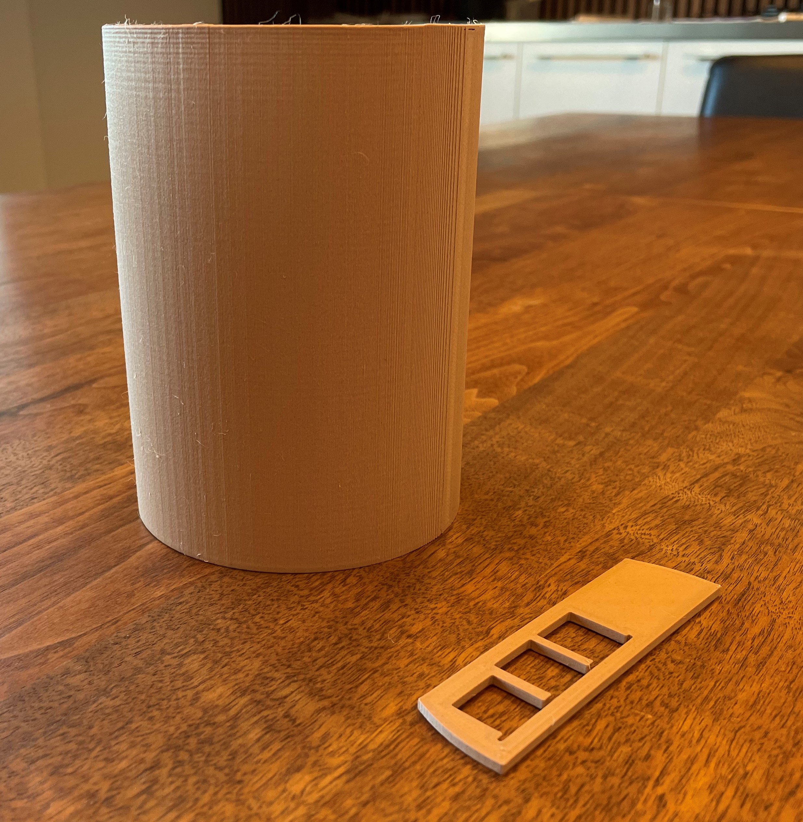
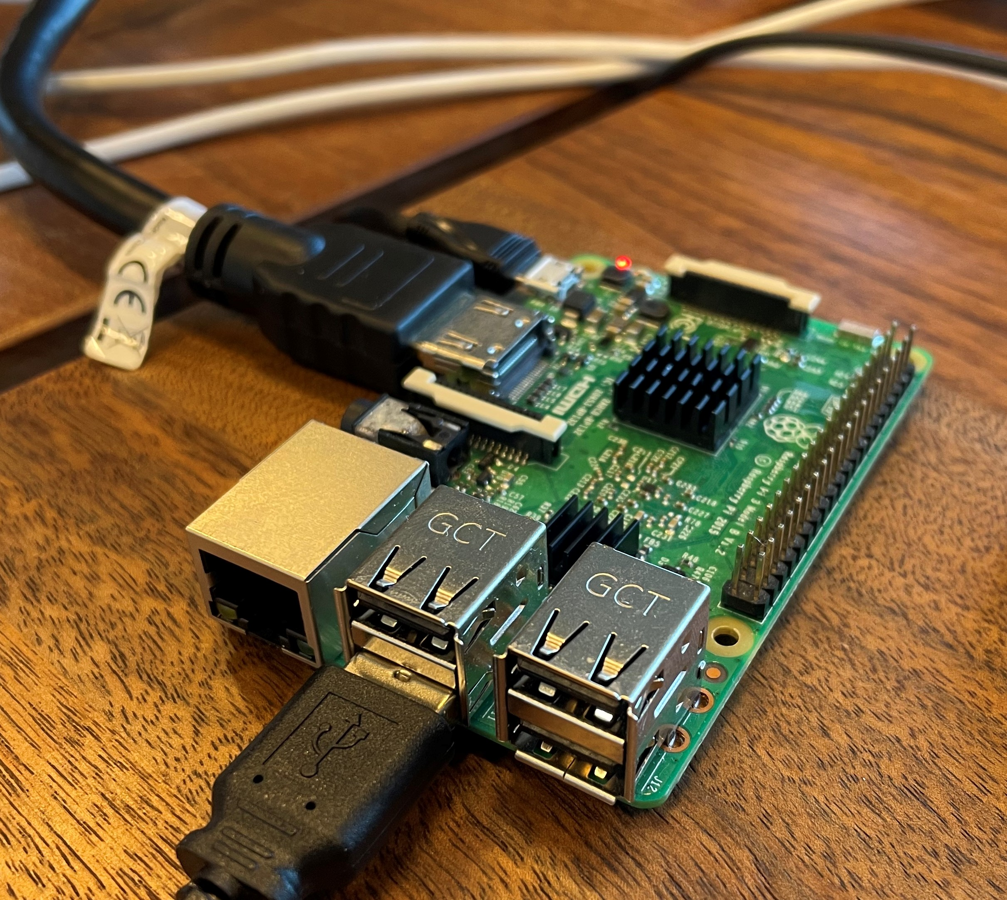
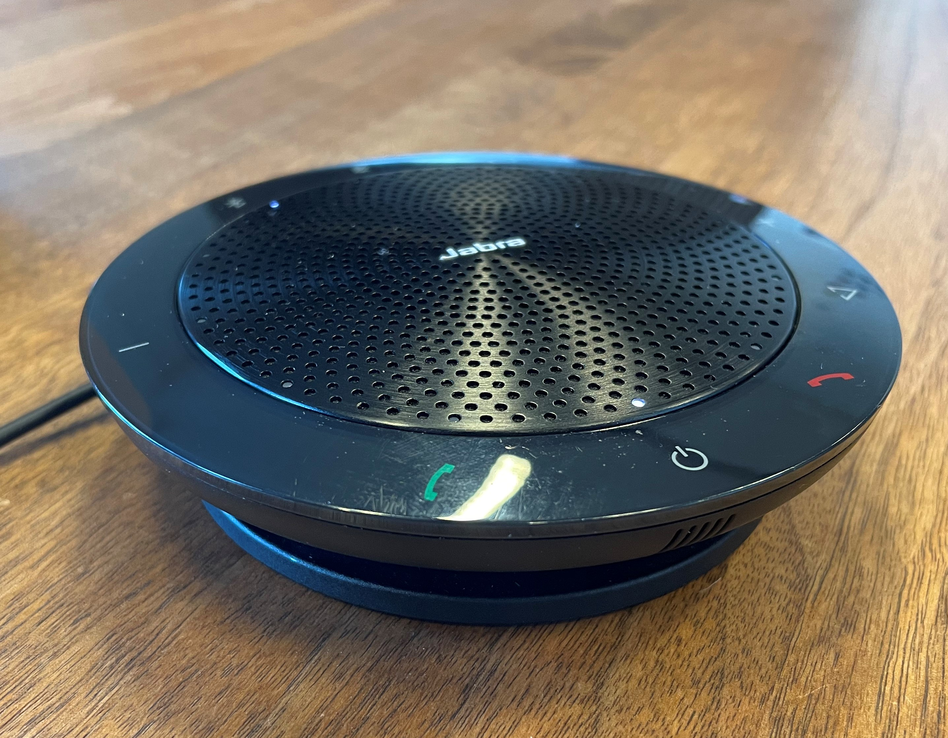
Tools

Slide 5
Usage
You first need an Amazon Developper Account
Configure the Pi with Raspbian Buster

Slide 6
Demo

Slide 7
Conclusion

